Slide 1
National Hydrology Project
Central Water Commission

Slide 2
Details of CPMU
SN | Name & Designation | Position in CPMU
1 | Member (RM) | Project Coordinator
2 | Chief Engineer, P&D | Nodal Officer
3 | Director, RDC-1, CWC | Project Director
4 | Deputy Director, RDC-1 | Procurement officer
5 | Chief Engineer, BPMO | Nodal, River Basin Planning and Extended Hydrological Prediction
6 | Chief Engineer, FMO | Nodal, Stream Flow Forecast Dissemination
7 | Chief Engineer, HSO | Nodal, Sedimentation Studies, Assessment of Aquatic Life in major rivers, Regional Models for water availability and HDA

Slide 3
Details of Field set up of cwc headed by Chief Engineer
S.No | Organisation | Place
1 | Yamuna Basin Organisation | New Delhi
2 | Narmada Basin Organisation | Bhopal
3 | Narmada and Tapi Basin Organisation | Gandhinagar
4 | Indus Basin Organisation | Chandigarh
5 | Upper Ganga Basin organisation | Lucknow
6 | Lower Ganga Basin organisation | Patna
7 | Teesta Basin Organisation | Siliguri
8 | Brahmaputra & Barak Basin Organsiation | Shillong
9 | Mahanadi & Eastern River Basin Organisation | Bhubaneswar
10 | Krishna & Godavari Basin Organisation | Hyderabad
11 | Cauvery & Southern River Basin Organisation | Coimbatore
12 | Monitoring Central Organisation | Nagpur

Slide 4
Funds Received and Expenditure till date
2016-17 |  | 2017-18
Budget Estimate | Expenditure | Budget Estimate | Expenditure
13.25 crores | 0.22 crore | 33.72 crores | Rs. 54 Th. (upto July 2017)
Reason of less booking
Operationlisation of PFMS system from July, 2017 in CWC Procurement through GeM portal

Slide 5
PIP
Water Resources Data Acquisition System
Real Time Data Acquisition System (RTDAS) for Surface Water | A1.1.01 | RTDAS for CWC | Goods | 2023 | NCB
IT Equipment for Data Centres | A3.4.01 | Purchase of office equipment including computers, server, software, furniture etc. | Goods | 1477 | shopping
Water Resources Information System (WRIS)
Strengthening National / State WRIS | B1.1.01 | Center of Excellence, Hyderabad, Procurement of hardware, software, spatial data sets, toposheets etc | Goods | 2203 | NCB
Strengthening National / State WRIS | B1.1.02 | Extension/upgradation of eSWIS software | Goods | 297 | Direct Contracting
Development / Procurement of Spatial Databases | B1.2.01 | Satellite product and spatial data set for proposed study of IWRM, EHP, Sediment & FF | Goods | 1000 | Direct Contracting

Slide 6
PIP
Water Resources Operation and Planning System
Decision Support System for River Basins (River basin management platform) | C1.1.01 | RBM for 18 basin | CS | 10000 | QCBS
Decision Support System for River Basins (River basin management platform) | C1.1.02 | Basin wise EHP model for medium & long term forecast | CS | 2000 | QCBS
Decision Support System for River Basins (River basin management platform) | C1.1.03 | Physical based mathematical modeling for sediment rate estimation and sediment transport in the river basin | CS | 1350 | QCBS
Decision Support System for River Basins (River basin management platform) | C1.1.04 | Development of Regional Models for water availability | CS | 250 | QCBS
 | C1.1.05 | Aquatic life assessment in major rivers of India | CS | 400 | QCBS
Flood Forecasting System for River Basins | C1.2.01 | Streamflow forecasting system | CS | 1500 | QCBS
Institutions Capacity Enhancement
Construction of Knowledge Centres | D1.1.01 | Center of Excellence, Hyderabad | CW | 1700 | DC

Slide 7
PIP
IT Equipment for Knowledge Centres | D1.4.01 | IT Equipment, Server, software, furnishing, furniture, misc equipment etc. | good | 1200 | NCB
Trainings | D2.1.01 | International Trainings/study tour/awareness program/conference/seminar | NCS | 900 | Shopping
Trainings | D2.1.02 | National Training programmes/in house training/Workshop /seminar/conference | Goods | 300 | Shopping
Establishment of PMU | D3.1.01 | R&M of CPMU including hiring of vehicles, consumables, travelling expenses, O&M of equipment, technical assistance etc. | Goods | 400 | Shopping
Incremental Staff Cost | D4.1.01 | Hiring technical expert/data entry operator/ It expert/MTS/ other expert | O&M | 500 | Shopping

Slide 8
AWP 2016-17
Item code | Item | Amount (in Lakh) | Status
A1.1.01 | Real Time Data Acquisition System (RTDAS) for Surface Water (Invitation of Tender of Framework document) | 1.53 | Hydromet sites was finalised in A.P
A3.4.01 | Purchase of ARC GIS software for NWA, Pune | 79.50 | Purchased
B1.1.02 | Advance payment for Extension/upgradation of eSWIS software | 13.10 | Price bid from M/s Eptisa was invited, contract document under approval
C1.1.01 | IWRM Study of 3 Basin (Invitation of Tender) | 1.53 | Tender was invited and RFP under approval
C2.2.01 | Streamflow forecasting system (Invitation of Tender of manpower hiring) | 1.53
D3.1.01 | R&M of CPMU including hiring of vehicles, consumables, travelling expenses, O&M of equipment, technical assistance etc. | 1.00

Slide 9
Major Procurement items in AWP 2017-18
Item code | Item | Amount (in INR Lakh) | Status
A1.1.01.02 | Real Time Data Acquisition System (RTDAS) for CWC | 160 | Specification is finalised under Framework Agreement. Hydromet sites is under process of finalization in J&K. Bid preparation is in progress
B1.1.02.02 | Advance payment for Extension/upgradation of eSWIS software | 100 | Case has been sent to Ministry for approval
B1.2.01.01 | Procurement of Spatial Data sets and Satellite products | 20
C1.1.01.03 | IWRM Study of 3 Basin | 500 | RFP prepared and sent to MoWR, RD &GR for approval
C1.2.01.03 | Stream-flow forecasting system | 200 | ToR has been prepared and Bid document will be finalised after TAMC in place.
D1.4.01.01 | GIS & RS Software | 75

Slide 10
Major Procurement items in AWP 2017-18
AWPID | Activity Name | Quantity | Amount | Status
A1.1.01.02 | RTDAS for CWC | 50 | 160 | Hydromet sites in J&K is not finalised. Bid document is being prepared.
A3.4.01.02 | Purchase of Computers, Printers, Scanner & other Accessories | 10 | 10 | Some procurement has done and amount will reflect in September, 2017
A3.4.01.03 | Server | 2 | 10
A3.4.01.04 | Photocopier (Colour/B/W) | 2 | 6 | In the process of procurement.
A3.4.01.05 | Office Furniture | 0 | 5
B1.1.02.02 | Advance payment for Extension/Upgration or eSWIS software | 0 | 100 | Approval is awaited
B1.2.01.01 | Procurement of Spatial Data sets and Satellite products | 0 | 20
C1.1.01.03 | IWRM Study of 3 Basin | 2 | 500 | Approval of RFP is awaited
C1.1.02.01 | Basin wise EHP model for medium & long term forecast | 0 | 1.6 | ToR will be prepared in consultation with TAMC
C1.1.03.01 | Physical based mathematical modeling for sediment rate estimation and sediment transport in the river basin | 0 | 1.6 | ToR will be prepared in consultation with TAMC. Amount kept for Advertisment only.

Slide 11
Major Procurement items in AWP 2017-18
AWPID | Activity Name | Quantity | Amount | Status
C1.1.04.01 | Development of Regional Models for water availability | 0 | 1.6 | ToR will be prepared in consultation with TAMC. Amount kept for Advertisment only.
C1.2.01.03 | Stream-flow forecasting system | 0 | 200 | ToR will be prepared in consultation with TAMC
D1.4.01.01 | GIS & RS Software | 3 | 75
D2.1.01.01 | International training/study tour/awareness program/conference/seminar | 0 | 200
D2.1.02.02 | National Training programmes /in house training /Workshop /seminar/conference | 0 | 50
D3.1.01.02 | R&M of CPMU including purchasing/ hiring of vehicles, consumables, travelling expenses,O&M of equipment, technical assistance,etc. | 0 | 30
D4.1.01.01 | Hiring technical expert/data entry operator/ IT expert/MTS/other expert | 0 | 30

Slide 12
Physical Progress
Activity | Present Status
Framework Agreement for the Empanelment of Hydro-meteorological and Water Quality Equipments | Cancelled. Only Specifications of the equipment will be sent to IA’s
Extension/ Upgradation of e- SWIS | Draft Contract document finalised and under approval
IWRM Studies of three Indian River Basin ( Krishna, Godavari and Mahanadi) | EoI has been floated and examined, RFP is in final stage of approval
Flood Early warning system. | Tender document was prepared but now decided to revise it after TAMC in place
Physical based mathematical modeling for sediment rate estimation and sediment transport in the river basin | ToR will be revised in consultation to TAMC
Development of Regional Models for water availability | ToR will be revised in consultation to TAMC

Slide 13
Physical Progress
Activity | Present Status
Centre of Excellence | Concept note is under preparation

Slide 14
Status of data entry in eSWIS
Following States has joined eSWIS system as on date:
Gujarat
Punjab
Kerala
Andhra Pradesh
Rajasthan
Karnataka
Maharashtra
Tamilnadu
Chattisgarh
Goa
Madhya Pradesh
Odisha
Data of H.O sites of CWC has been entered upto July, 2017

Slide 15
Administrative Hierarchy of organisation for getting registered in the eSWIS, (Both for Surface Water & Ground Water)
Owner Agency: (Full Name)
HIS Agency:(Full Name)
State/Regional office: (Full Name)
Circle Office: (Full Name)
Divisional Office: (Full Name)
Sub Divisional Office: (Full Name)
Section Office/Junior Engineer Office; (If any, Full Name)

Slide 16
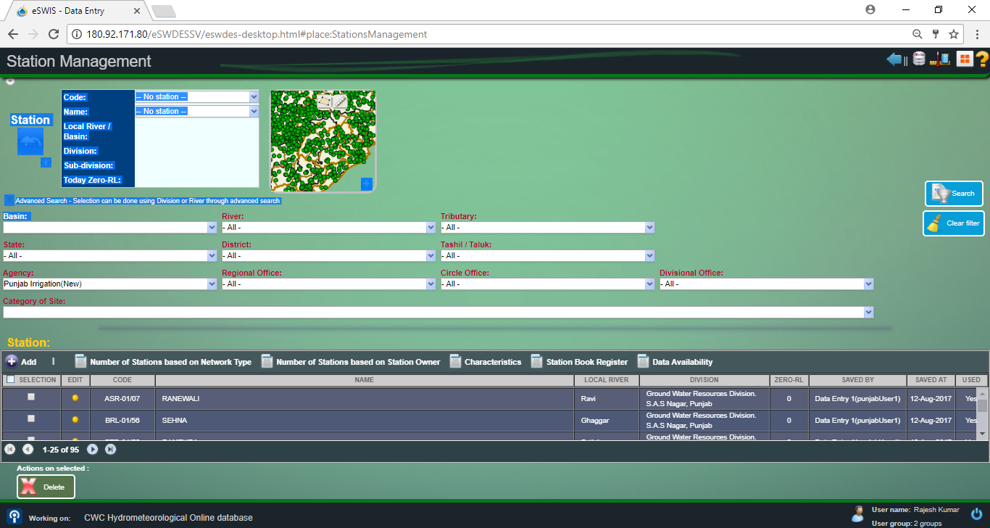

Slide 17
Status of Optimization of Hydro-met station
S.No | States | Implementing Agencies |  |  | Hydromet Stations tentenvily finalsed with IA's after meeting | Signed copy recd
 |  | Total proposed Hydromet Stations by State | Overlap | Balance Hydro-met Stations of State
Hydromet Sites finalised
1 | Andhra Pradesh | 43 | 7 | 36 | yes
2 | Arunachal pradesh | 46 | 18 | 28 | yes | Yes
3 | Bihar | 50 | 34 | 16 | yes | Yes
4 | Karnataka | 329 | 156 | 173 | yes
5 | Maharashtra | 541 | 283 | 258 | yes
6 | Manipur | 50 | 37 | 13 | yes
7 | Mizoram | 74 | 28 | 46 | yes
8 | Odisha | 275 | 180 | 95 | yes
9 | Rajasthan | 363 | 242 | 121 | yes
10 | Tamilnadu | 53 | 15 | 38 | yes
11 | Tripura | 52 | 18 | 34 | yes
12 | Uttar Pradesh | 45 | 2 | 43 | yes
13 | Nagaland | 46 | 20 | 26 | yes
14 | DVC | 87 | 46 | 41 | yes

Slide 18
Status of Optimization of Hydro-met station
Hydromet Sites under finalisation
1 | Chhattishgarh | 214 | 18 | 196 | yes
2 | Gujarat | 328 | 103 | 225 | yes
3 | Madhya Pradesh | 334 | 47 | 287 | yes
4 | Telangana | 33 | 10 | 23 | No
5 | Punjab | 26 | 9 | 17 | yes
6 | West Bengal | 125 | 24 | 101 | No
7 | Jharkhand | 31 | 13 | 18 | No
8 | Haryana |  |  |  |  | recd
9 | Assam |  |  |  |  | recd
10 | Meghalaya |  |  |  |  | recd
11 | Himachal Pradesh
12 | Goa |  |  |  |  | recd
13 | BBMB |  |  |  |  | recd
14 | Sikkim
15 | J&K |  |  |  |  | Under Finalisation by CWC
16 | Uttarakhand
17 | Kerala

Slide 19
Way Forward

